Slide 1
Predictive Analysis of Everything Data’s GRADUATION RATEs
Tevin b. ochieng
DATA SCIENCE
September 17th, 2025
06:25pm eat (10:25AM CT)
EVERYTHING DATA AFRICA

Slide 2
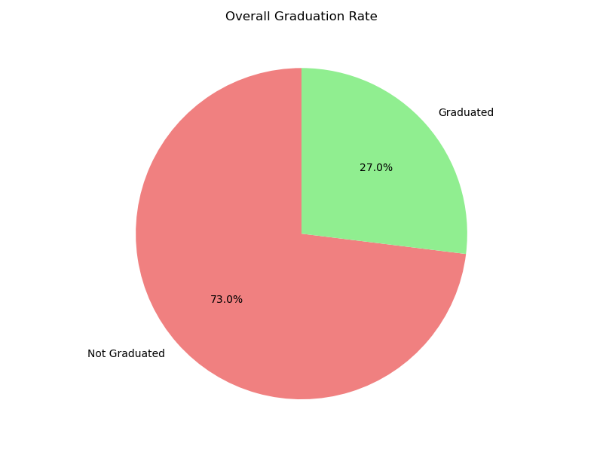
Problem statement
Core Challenge:
How can we increase the 27% Graduation Rate at Everything Data’s Mentorship Program?
Specific Problems Identified:
No systematic way to predict at-risk participants
Limited understanding of success factors
High dropout rate despite quality mentorship

Slide 3
RESEARCH QUESTIONS
Which factors most strongly predict graduation?
Can we build reliable models to identify at-risk participants?
What actionable changes would yield maximum impact? (Higher G.R)

Slide 4
Analysis workflow
Phase 1: Data Loading & Preprocessing
Data from Nov-Dec 2024 Successful Applicants
Data from DA and DS Merged into a single CSV File
15 variables recorded, zero critical missing values
Demographic, Experience, Commitment, and Performance metrics
Phase 3: Predictive Modeling
Train/test split (80/20) with stratified sampling
Algorithm comparison: Logistic Regression vs Random Forest
Feature engineering and scaling optimization
Phase 2: Exploratory Data Analysis
Data Encoding and Scaling
Demographic Segmentation Analysis
Success rate comparison across participant groups
Correlation analysis revealing key relationships
Phase 4: Model Evaluation
Metric assessment (accuracy, precision, recall, F1)
Confusion matrix analysis for prediction reliability
Feature importance ranking for quality insights

Slide 5
DATA ENCODING
Transforming Categories into Numbers for Machine Learning Applications. In this case, the application being predicting the graduation rate at Everything Data Africa.
Ordinal Encoding: Preserving Natural Order
Binary Encoding: Simple Yes/No Conversions
Graduated: Yes = 1, No = 0 (Target variable)
Test Completed: Yes = 1, No = 0 (Participation indicator)
Variable | Original Categories | Encoded Values | Rationale
Experience | Less than 6 months → 4-6 years | 0 → 3 | Natural Progression of Expertise
Hours/Week | <6 hours → >14 hours | 1 → 3 | Increasing commitment levels
Skill Level | Beginner → Advanced | 1 → 4 | Learning proficiency hierarchy
Age Range | 18-24 → 45-54 years | 1 → 4 | Life stage progression
Label Encoding: Nominal Categories
Track: Data Science/Data Analysis → 0/1
Gender: Male/Female → 0/1
Country: Kenya/South Africa → 0/1

Slide 6
MODEL SELECTION JUSTIFICATION
🎯 PROBLEM ALIGNMENT
Binary Classification Task: Predict graduation (Yes/No) outcome
Small Dataset (115 participants): Both algorithms perform well with limited data
Mixed Feature Types: Handle categorical + numerical variables effectively
📊 LOGISTIC REGRESSION: The Interpreter
Why?
Transparent Coefficients: Clear positive/negative impact of each factor
Statistical Rigor: P-values and significance testing for evidence-based decisions
Stakeholder Communication: Easy to explain to program managers
Probability Outputs: Risk assessment scores for intervention planning
🌲 RANDOM FOREST: The Pattern Finder
Why?
Complex Relationships: Captures non-linear interactions (score × hours combinations)
Robust Performance: Handles outliers and mixed data types naturally
Feature Importance: Ranks predictors without manual engineering
Proven Track Record: Industry standard for educational outcome prediction

Slide 7
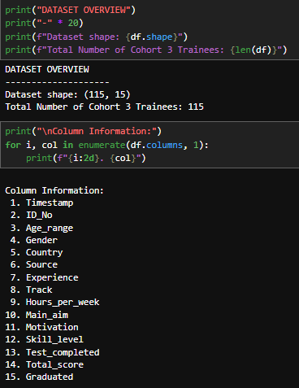
Dataset Overview
115 participants, 15 variables, Nov-Dec 2024
Kenya-focused Cohort: 99.13% - Kenya, 0.87% SA
Overall Graduation Rate: 27%
Clean dataset, zero missing values in features

Slide 8
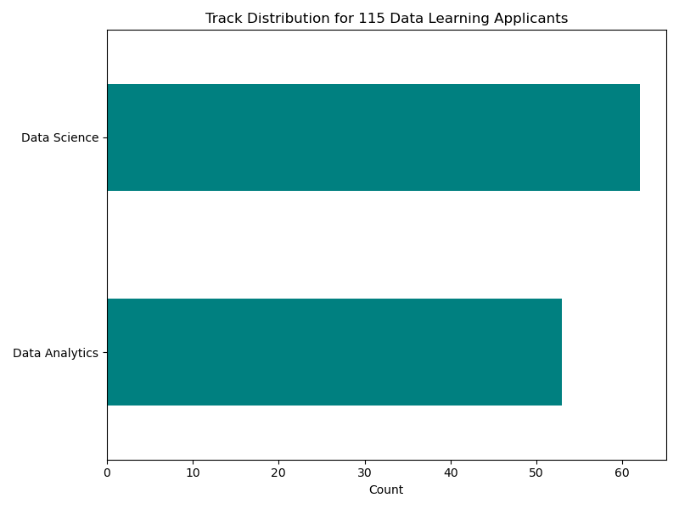
EDA
62
53

Slide 9
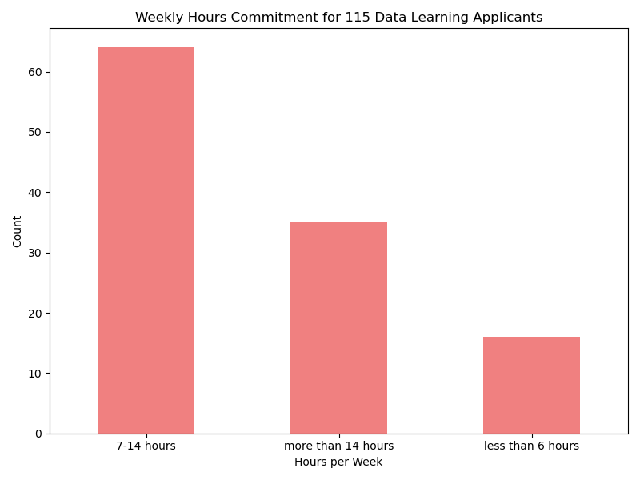
EDA
64
35
16

Slide 10
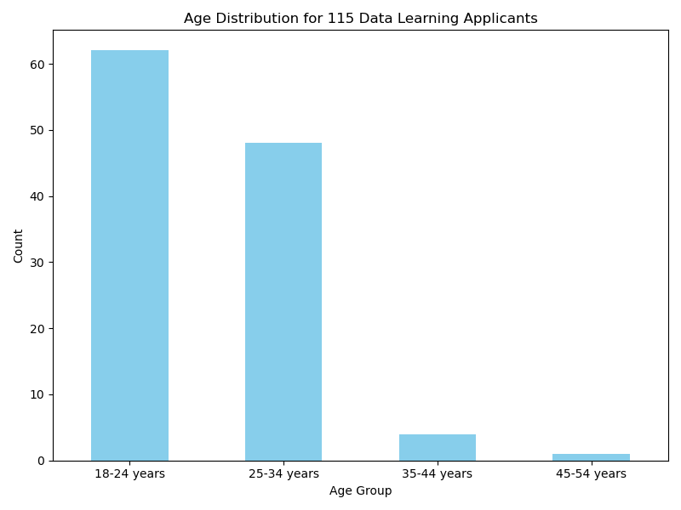
EDA
Majority of participants are young adults (18-34 years)

Slide 11
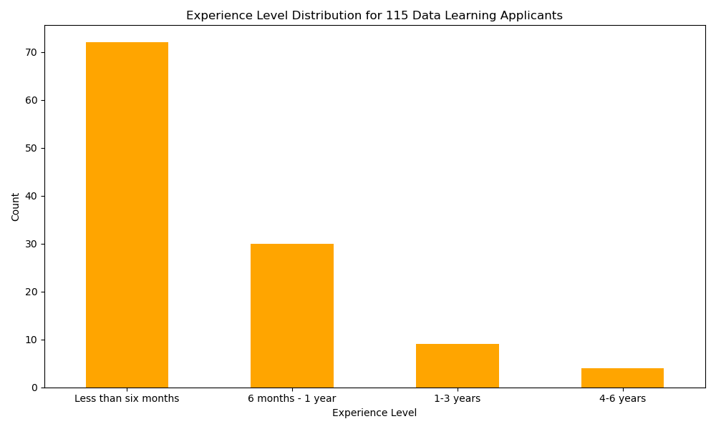
EDA
Majority of participants have less than six months of experience in data

Slide 12
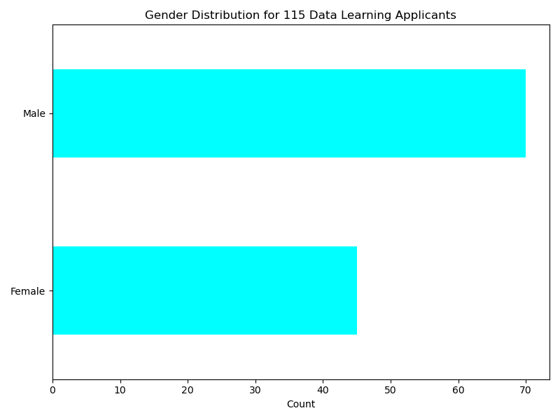
EDA
70
45

Slide 13
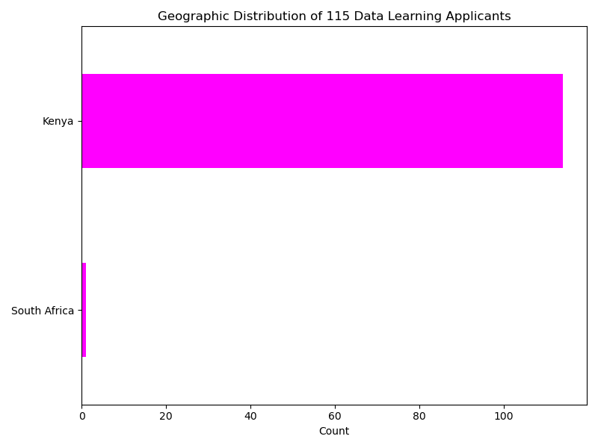
EDA
114
1

Slide 14
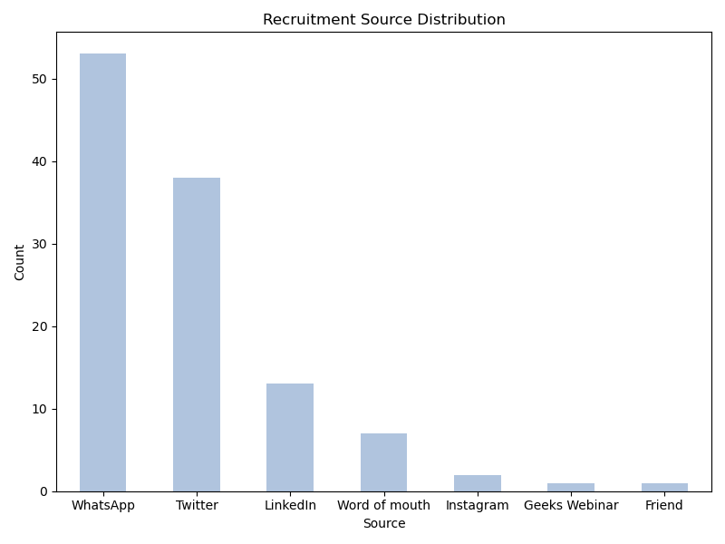
EDA

Slide 15
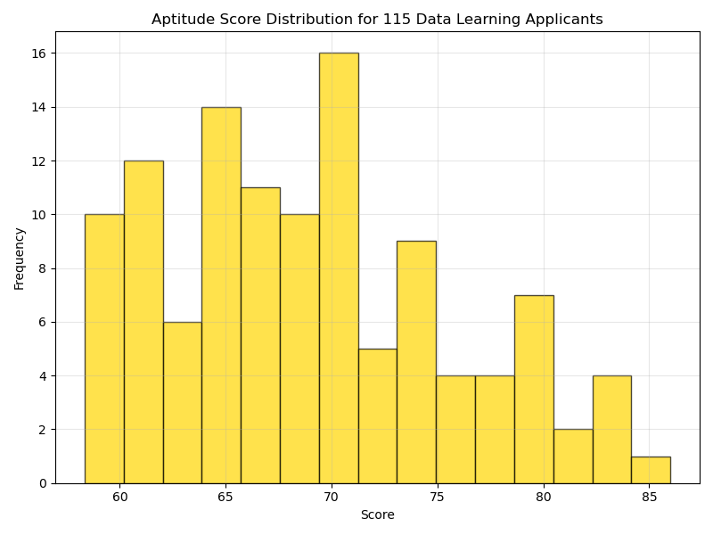
EDA

Slide 16
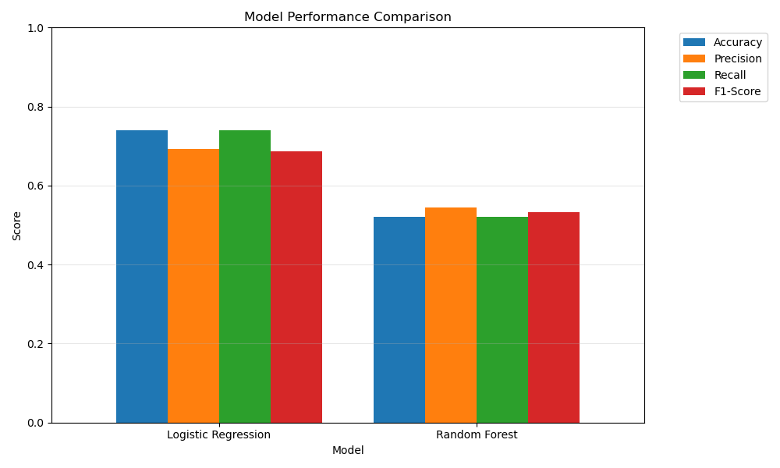
EDA

Slide 17
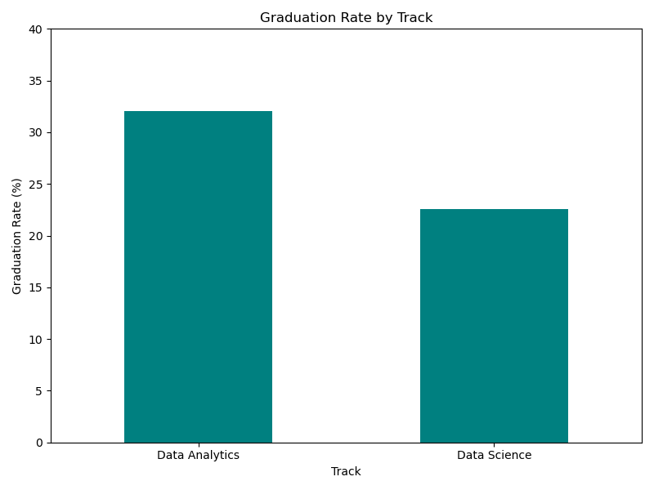
EDA
32.08%
22.58%

Slide 18
Key insights
1: Aptitude Score Dominance
Strongest Predictor (Imp. = 0.378)
Score >70: 45.50% graduation rate (n=47)
Score 60 – 70: 34.50% graduation rate (n=58)
Score <60: 20% graduation rate (n=10)
2: Commitment Impact
Importance = 0.143
More than 14 hours/week: 34.3% graduation rate (n=35)
Less than 6 hours/week: 31.2% graduation rate (n=16)
7 – 14 hours/week: 21.9% graduation rate (n=64)
3: Experience Advantage
Importance = 0.119
4 - 6 years: 75% graduation rate (n=4)
Less than 6 months: 27.8% graduation rate (n=72)
6 months – 1 year: 23.3% graduation rate (n=30)
1 – 3 years: 11.1% graduation rate (n=9)

Slide 19
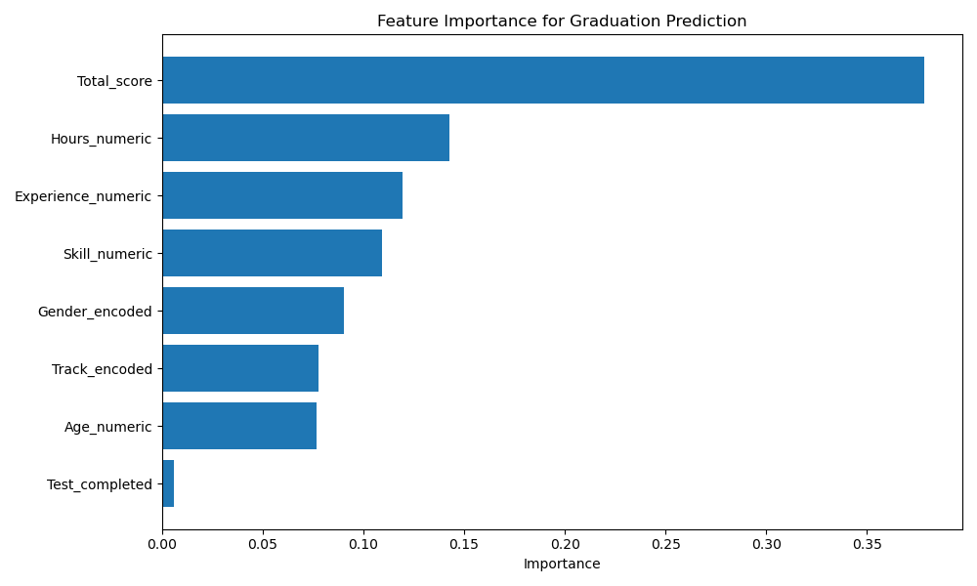
Feature importance analysis - rf
Aptitude Score is #1 predictor (Importance = 0.378)
Weekly hours commitment matters significantly (Importance = 0.143)
Experience Level is the third most significant predictor (Importance = 0.119)

Slide 20
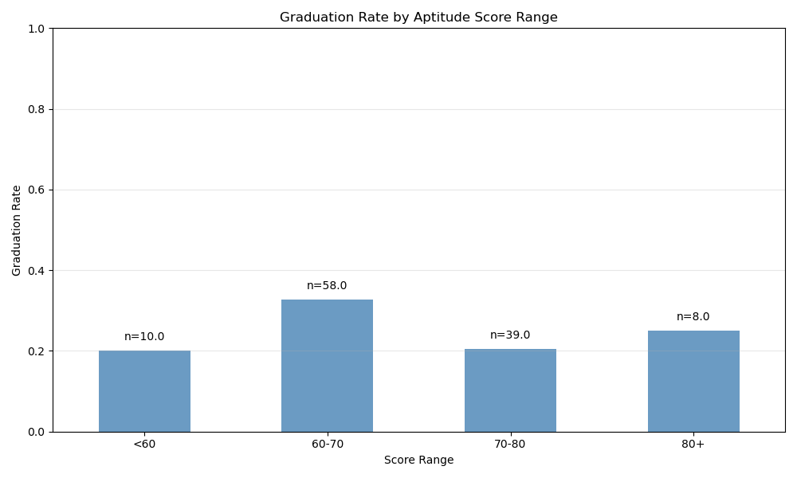

Slide 21
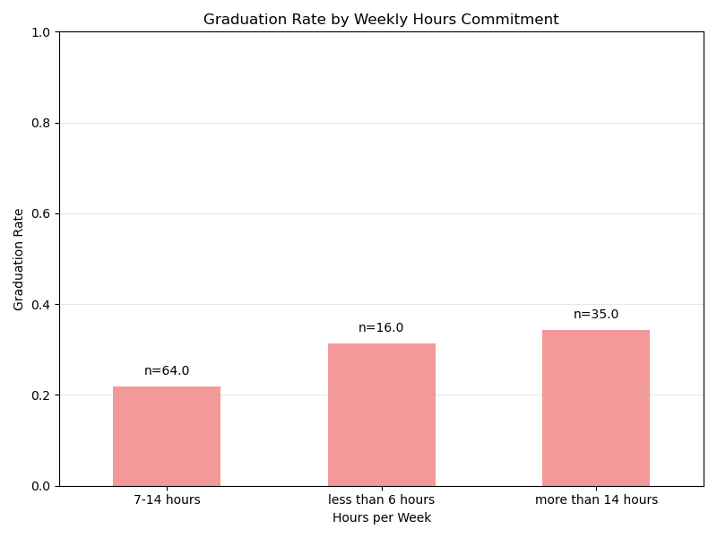

Slide 22
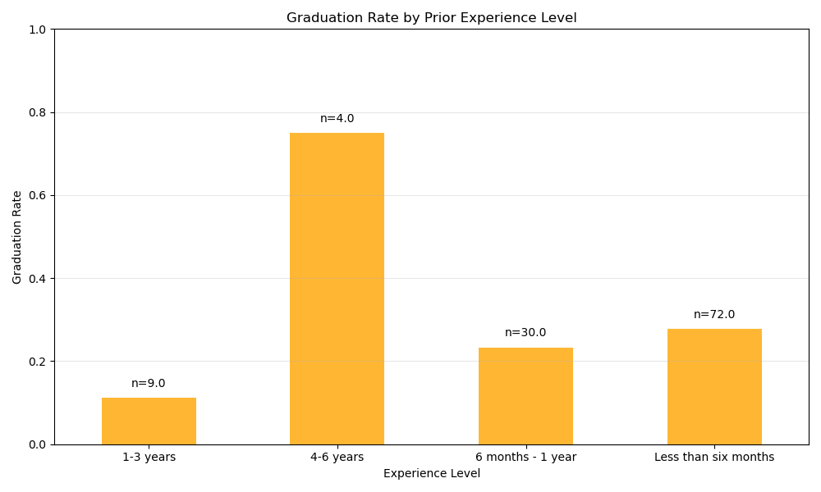

Slide 23
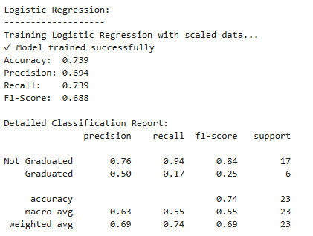
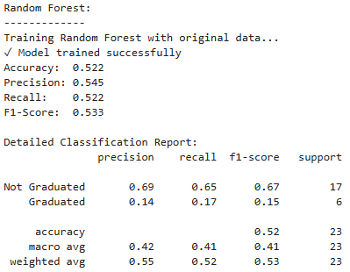
MODEL PERFORMANCE COMPARISON

Slide 24
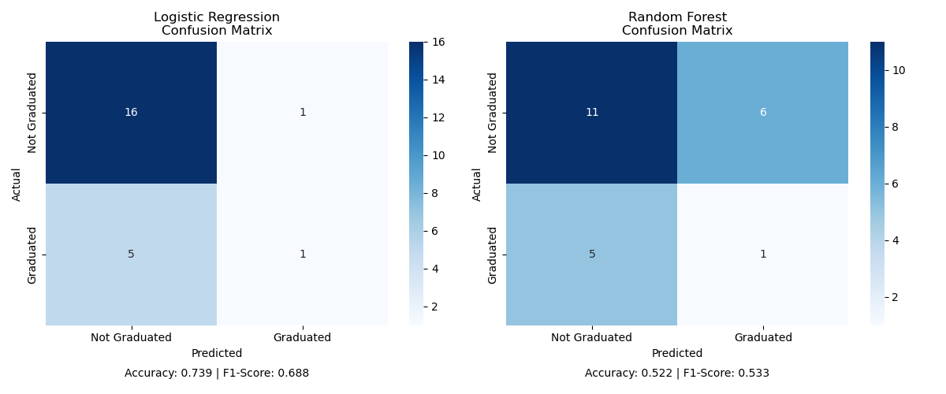
CONFUSION MATRIX COMPARISON

Slide 25
Strategic Recommendations
1. Implement an Admission Threshold
Prioritize candidates with higher aptitude test scores
Minimum ATS: 65%
Priority placement for 75%+ ATS
2. Differentiated Support Structure
Enhanced mentorship for beginners
Emphasize the Peer mentorship system implementation
Weekly check-ins for at-risk participants based on DataCamp activity
3. Recruitment Strategy
Emphasize time commitment requirements clearly
Target participants with some prior experience in data

Slide 26
Thank you
QUESTIONS?
Tevin Billy Ochieng
+1 (605)-659-1484
MSc. Business Analytics, University of South Dakota
vindevon11@gmail.com

